Slide 1
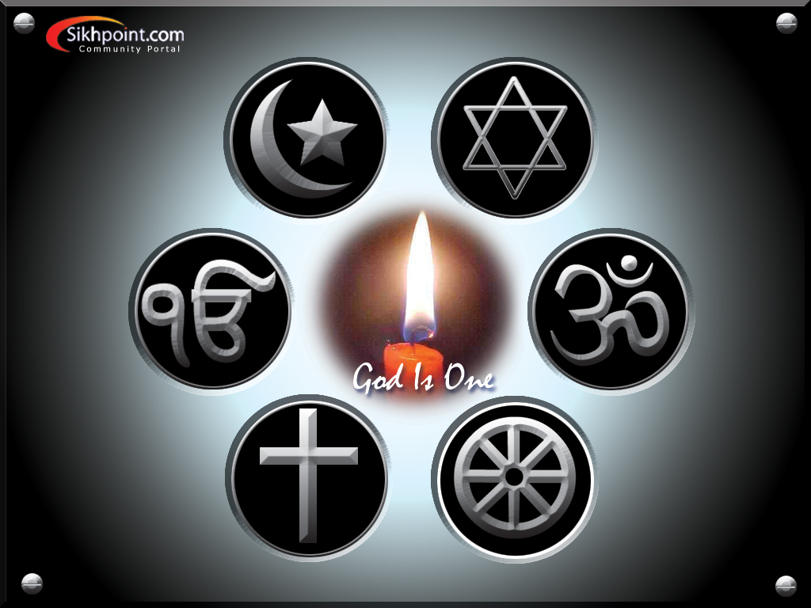
REAL NAME, ALLAH OR RAM?
DR GURBAKSH SINGH

Slide 2
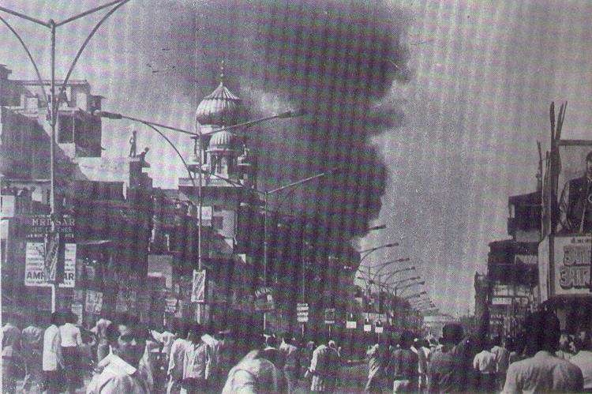
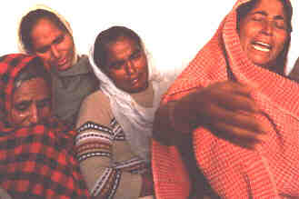
The recent history of India is full of Hindu and Muslim clashes because of the lack of their mutual confidence (faith).
The country was divided into Hindu India and Muslim India (Pakistan) in 1947.
Bloodshed took place on a very large scale. Just a thought of those events sends a chill through body even today.
Millions of people, had to move from one side of the dividing line to the other.
About two decades later, an incident in family in the mid-sixties reminded of this tragedy and made me feel that we have ignored the real contribution of Guru Nanak to humanity.

Slide 3
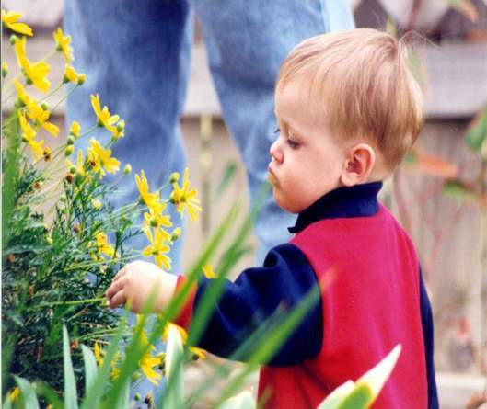
One day, just before leaving for school, my daughter as usual said, "Dar jee, we are leaving.“
My son, who was also ready to go along with her, suddenly lost his temper.
He was about to hit her, when he saw me watching both of them.
He, therefore, with-held his hand and, while murmuring something, left for his school. When they returned from their school, I called both of them into the yard where I was busy studying a book.
Addressing my son, I asked, "Why did you get mad in the morning? She did not say anything to you."
With some reflections of the morning anger, he said, "She insulted us.

Slide 4
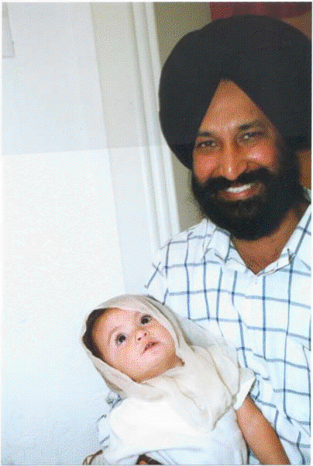
Does she not know how to address you?
She said dar jee to you in the presence of the professor from Delhi.
Will he not think that we are uncultured and rustic people? Does she not know that the father is addressed as daddy.
Only uneducated village folk say dar jee.
I felt ashamed to hear that.
Tell her not to use this word again." After completing my M.Sc. Agr. in 1951, I was appointed at Fodder Research Station Sirsa, in Haryana state.
I was the only Sikh in the unit and everybody addressed me as Sardar jee.
Many persons did not even know my name.
There, we were blessed with our first child, a daughter.
She addressed me as dar jee.

Slide 5

I was transferred to the Agricultural University, Ludhiana in 1956. There my son was born.
All the children at the university campus called their father daddy. My son, therefore, assumed that the word daddy is used in educated society, whereas dar jee is used in rural society.
Accordingly, I was daddy for my son and dar jee for my daughter.
Till then, we never noticed this difference in our family but I will never forget it for the rest of my life because of the lesson I learnt from it.
The morning incident had brought the two different names to my attention.
My son lost his temper because he could not tolerate to hear the word dar jee in the presence of an outsider.

Slide 6
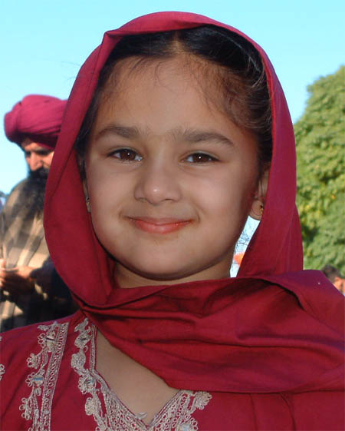
The dialogue was heard by my daughter as well.
She was right there and listening to what her brother was saying.
I asked my daughter, "You may also call me daddy. Do you have any difficulty in it?“
She thought for a minute, took half a turn to look away from me, and whispered to herself, daddy.
She turned back to me and apologetically said, "Dar jee ! No, daddy is merely a word for me.
It does not make me feel that I am addressing you."It was followed by a silence, waiting for a response from me.
Hearing this, I could not hold my heart and was speechless.

Slide 7
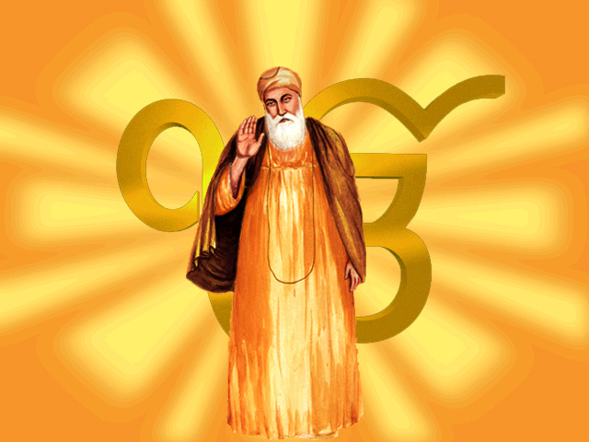
A minute later, I said to them, "O.K. Go, have your snacks, and finish your school work.
My eyes closed and a wave of thought went through my mind.
"Guru Nanak ! You were really great. Like children, we still fight and shed blood to decide whether to call God, Allah or Ram.“
Nobody in the family or any friend ever took notice of the two different names for more than six years.
Everything went smoothly.
Why should there be any problem when some people address our common Father as Ram while others love Him as Allah?
Guru Nanak ! You were really great. Like children, we still fight and shed blood to decide whether to call God, Allah or Ram.“

Slide 8
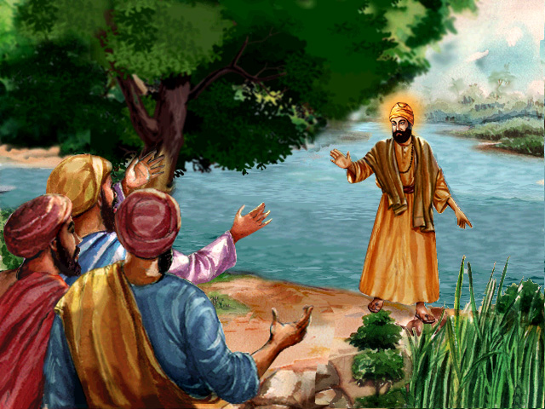
We have forgotten the first sermon the Guru gave after coming out of the river Bein.
His message to the people was "Na Koi Hindu, Na koi Musalman."
Do not divide people as Hindu or Muslim, inferior or superior, high caste or low caste.
We are children of the same Father, hence equal.
Anybody who loves Him (by any name) realizes Him.
His message to the people was "Na Koi Hindu, Na koi Musalman."

Slide 9
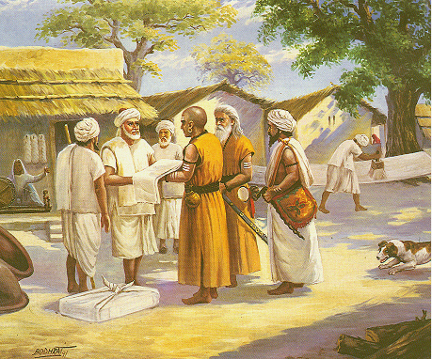
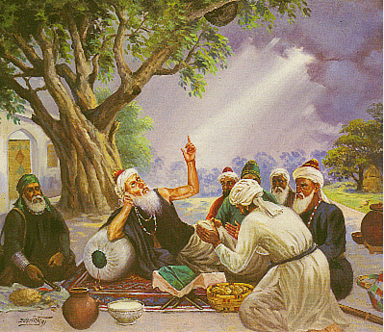
Hymns composed by Kabir, a low caste, Ravidas, a shoemaker and untouchable, Baba Farid, a Muslim, and many other devotees are included in the Sikh scriptures.
They all loved God by different names and realized Him.
Kabir, a low caste
Baba Farid, a Muslim

Slide 10
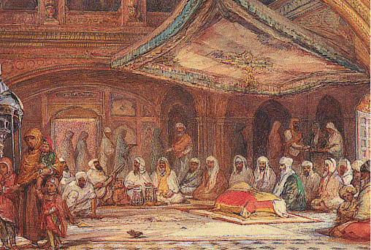
Why have we failed to understand this simple message which is revealed throughout the Guru Granth Sahib?
The division of the country in 1947 and the bloodshed, which followed and is continuing all over the world even today, could have been avoided.

Slide 11
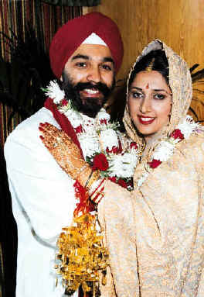
I was the same person again, Dar jee to my daughter, and daddy to my son.
As long as I live, both names are going to be with me.
Though, my son-in-law and my daughter-in-law call me daddy but for my grandson, I continue to be Dar jee the name he picked up from my daughter.
I beg my fellow Sikhs to understand and also share the teachings of Guru Nanak with all people whom they meet.
If they write articles about it and also live their life with this belief, the world will become a better place to live in than what it is today.

Slide 12

God judges us not by the name with which we address Him, but by the deeds we do.
Let every Sikh tell people that Allah, Ram, Guru, God, and all other names are equally loved by Him.
Let people choose any name they like to address Him.
God judges us not by the name with which we address Him, but by the deeds we do.

